Slide 1
Welcome to Safeguarding 101 – Introduction to Safeguarding From the Resource and Support Hub We will be starting Shortly
Housekeeping
You are on mute with video off to support connection
Chat is enabled to panelists to support with tech issues
Use the Q&A function to ask questions throughout the presentations. It is in the controls panel on the bottom of the screen

Slide 2
About RSH (Safeguarding Resource & Support Hub)
RSH aims to support organisations in the aid sector to strengthen their safeguarding policy and practice against SEAH.
Visit https://safeguardingsupporthub.org/ for global tools, resources, evidence, news and events and also navigate to Nigerian Hub Page
Smaller, local organisations in developing countries are the Hub’s focus. The hub is implemented in Ethiopia, South Sudan and Nigeria
As we identify major gaps, we will look for ways to fill them, in collaboration with other partners and networks. Approaches can be through development of resources, mentorship, online training, webinars and podcasts.

Slide 3
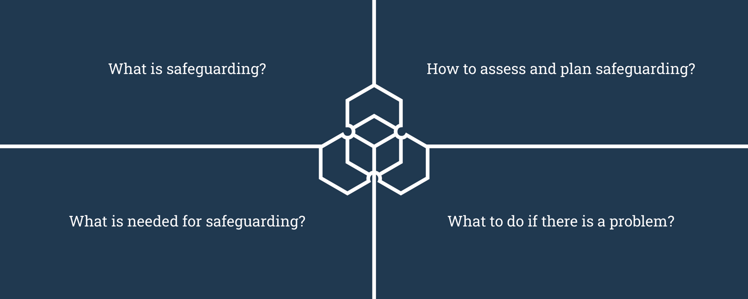
This webinar will cover:

Slide 4
1. What is safeguarding?
Current RSH working definition:
Safeguarding is an ethical approach and set of practical measures adopted by organisations to promote the safety and wellbeing of everyone involved in the delivery or receipt of humanitarian aid and development assistance, and to protect them as far as possible from all forms of harm, including exploitation, abuse and harassment that might result from their involvement in, or contact with, the organisation
4 | Document Title

Slide 5
What is safeguarding?
Or more simply:
We do not harm people who come into contact with us
5 | Document Title

Slide 6
Safeguarding Background
In an organisation, certain people sometimes have more power based on their gender, race, role in the organisation, disability, sexuality, nationality, employment status, or education. People with less power can be at greater risk of exploitation and abuse.
Sexual exploitation, abuse and sexual harassment (SEAH) involves people within organisations using their power in harmful ways against people who are less powerful, either in the organisation, in partner organisations or in the communities where the organisation works. Powerful people can also perpetrate physical and emotional violence. We refer to these other forms of violence as safeguarding violations.
SEAH impacts women and girls in particular, but it can also affect men and boys.
Safeguarding addresses the misuse of power

Slide 7
Global sector standards
DAC Recommendation on Ending Sexual Exploitation, Abuse, and Harassment in Development Co-operation and Humanitarian Assistance
The Interagency Standing Committee Minimum Operating Standards for Protection from Sexual Exploitation and Abuse (PSEA) by own Personnel
Core Humanitarian Standard on Quality and Accountability
Keeping Children Safe Standards
International Labour Organization Convention on Violence and Harassment in the Workplace

Slide 8
2. How to assess safeguarding
Self assessment tools help organisations identify which international safeguarding standards they currently meet and which ones they do not meet.
It is useful to conduct self assessments regularly to monitor and measure progress on safeguarding and to update plans.
Examples of tools include Core Humanitarian Standard Alliance tools and the Keeping Children Safe self-audit tool.
8 | The Safeguarding Journey

Slide 9
2. How to plan safeguarding
Organisations benefit from an organisation-wide safeguarding plan to continuously improve and maintain safeguarding measures.
Some organisations plan to meet international standards, others plan according to specific risks in different departments, teams, or locations.
It is important to clearly budget for safeguarding plans.

Slide 10
3. What is needed for Safeguarding?
Organisational standards: within human resources, programmes, partnerships, Culture and Leadership
Robust organizational standards show donors that the organisation is actively managing safeguarding
Organisational standards should align with international standards set by the aid and development sector

Slide 11
3. What is needed for Safeguarding?
Organisational culture and leadership
Safeguarding policies and Code of Conduct
Communication, Learning and Development
Communication with communities
Integration into relevant units of the organization
i. Human Resources
ii. Safe Programming
iii. Media and Communications (data protection)
iv. Fundraising
Notes:
Organisations can change their culture through leadership approaches. When leaders show respect and accountability in their relationships with others, they build safer and more effective organisations
Safeguarding principles should inform the whole project/programme cycle management
Safeguarding policies: A safeguarding policy explains an organisation’s commitments to preventing and responding to sexual exploitation, abuse, sexual harassment (SEAH), and other forms of harm.
Organisational Codes of Conduct explain the expected behaviours of staff and associates

Slide 12
4.What to do if there is a problem
Speak-up/whistle-blowing systems
A speak-up or whistle-blower system helps staff to report concerns about safeguarding, sexual exploitation, abuse, sexual harassment, and other forms of harm.
These systems need to be accessible to everyone and work for everyone. They should prioritise the survivor’s rights, needs and wishes.
All staff and associates must be confident that the system will support and protect them when they report a concern. The system should offer protection from complaints that try to cause harm to staff or associates.
The most effective systems are developed together with staff, to help recognise and address any barriers to reporting that a survivor may experience because of their gender, disability, race, age or other identities.

Slide 13
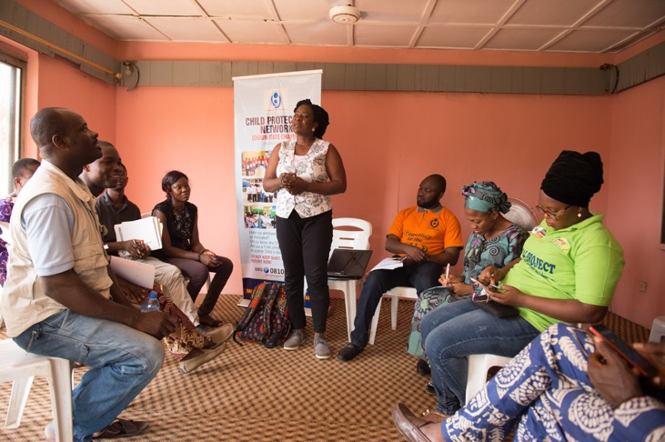
What to do if there is a problem
Community-based reporting mechanisms (CBRMs)
Every person who the organisation works with must have a way to report safeguarding, sexual exploitation, abuse, and sexual harassment concerns.
Community-based reporting systems must prioritise the survivor’s rights, needs and wishes.
Photo by Paul Robin

Slide 14
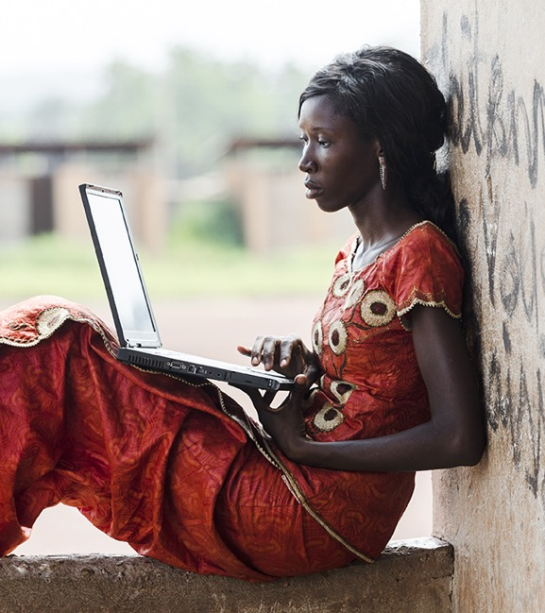
What to do if there is a problem
Case management
Reports received must be handled in line with organizational procedures
Survivor Centred Case management process must be ensured and involves referral to quality services. The survivor’s rights, needs, and wishes must be prioritised
Referring a case to national authorities for criminal prosecution when there is evidence to support allegations of sexual exploitation, abuse or sexual harassment (SEAH)
Administrative Investigations to be conducted by trained investigators
The safety and protection of everyone involved in safeguarding cases is extremely important.

Slide 15
Key things to remember along the Safeguarding Journey
Safeguarding is about keeping people safe from and addressing harm that has been caused by the organisation’s staff and/or associates misusing their power.
Sexual exploitation, abuse and harassment can happen in any organisation, anywhere.
Organisations need to understand where power lies in their organisation and leaders need to create a culture of respect and accountability.
Organisations need to regularly assess themselves against safeguarding standards, assess safeguarding risks, and create and monitor organisation-wide safeguarding plans.
To address safeguarding incidents, organisations need accessible systems that all staff, associates and people in communities can access. Organisations need clear case management procedures and investigations.

Slide 16
Explore the Online Hub for more…
Global
https://safeguardingsupporthub.org/
Nigeria Hub
https://nigeria.safeguardingsupporthub.org/
To continue the discussion on this webinar please log onto
https://safeguardingsupporthub.org/forum-topic/safeguarding-101-introduction-safeguarding-0
Sign up to our newsletter!

Slide 17
Questions and Answers

